Slide 1


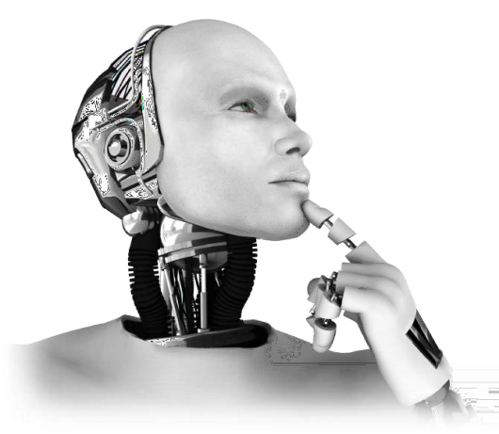


Project Lead – Mr. Mohit Kashyap
Developed
by
Mr. Hemant Gautam & Mr. Jane Alam
Group – 1H
Hemant & Jane

Slide 2

Breast Cancer Diagnosis
Hemant & Jane

Slide 3
Breast Cancer: An Overview
The most common cancer in women worldwide.
The principle cause of death from cancer among women globally.
Early detection is the most effective way to reduce breast cancer deaths.
Early diagnosis requires an accurate and reliable procedure to distinguish between Benign breast tumours from Malignant ones.

Slide 4

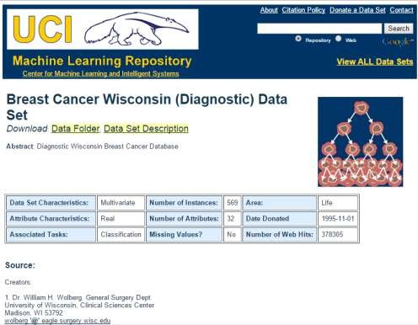
Objective
The objective of this project is to analyse the data, data pre-processing, and applying the best machine learning algorithm by comparing with different algorithms and choosing the best models to predict the type of the cancer (Malignant or Benign) based on the given dataset.
Link for the dataset(Classification Problem) - https://archive.ics.uci.edu/ml/datasets/Breast+Cancer+Wisconsin+%28Diagnostic%29
Hemant & Jane

Slide 5
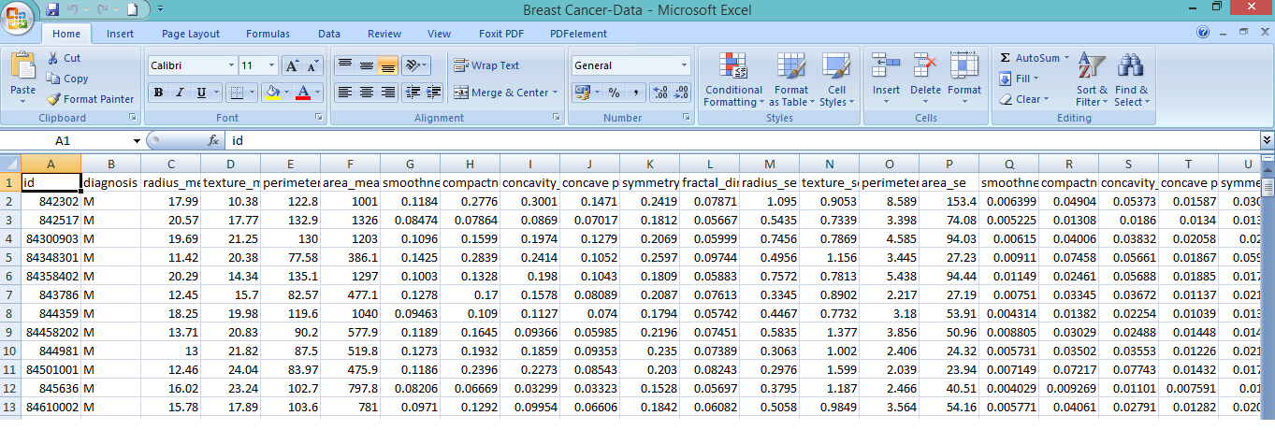
Dataset
Hemant & Jane

Slide 6
Dataset Details
Number of Rows – 569
Number of Columns – 32
Target Column – Diagnosis (M= malignant, B = benign)
Attribute Information
1) ID number 2) Diagnosis (M = malignant, B = benign) 3-32)
Ten real-valued features are computed for each cell nucleus:
a) radius (mean of distances from canter to points on the perimeter)
b) texture (standard deviation of grey-scale values)
c) perimeter
d) area
e) smoothness (local variation in radius lengths)
f) compactness (perimeter^2 / area - 1.0)
g) concavity (severity of concave portions of the contour)
h) concave points (number of concave portions of the contour)
i) symmetry
j) fractal dimension ("coastline approximation" - 1)
Hemant & Jane

Slide 7
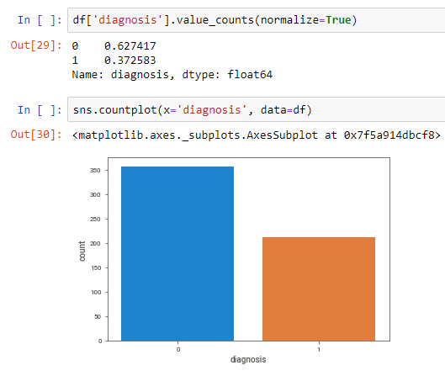
Malignant & Benign Counts
Benign
Malignant

Slide 8



Machine Learning Overview
What is Machine Learning and why are we using it?
Machine learning (ML) is a field of artificial intelligence that uses statistical techniques to give computer systems the ability to "learn" (e.g., progressively improve performance on a specific task) from data, without being explicitly programmed.
The process of learning begins with observations or data, such as examples, direct experience, or instruction, in order to look for patterns in data and make better decisions in the future based on the examples that we provide. The primary aim is to allow the computers learn automatically without human intervention or assistance and adjust actions accordingly.
ML

Slide 9
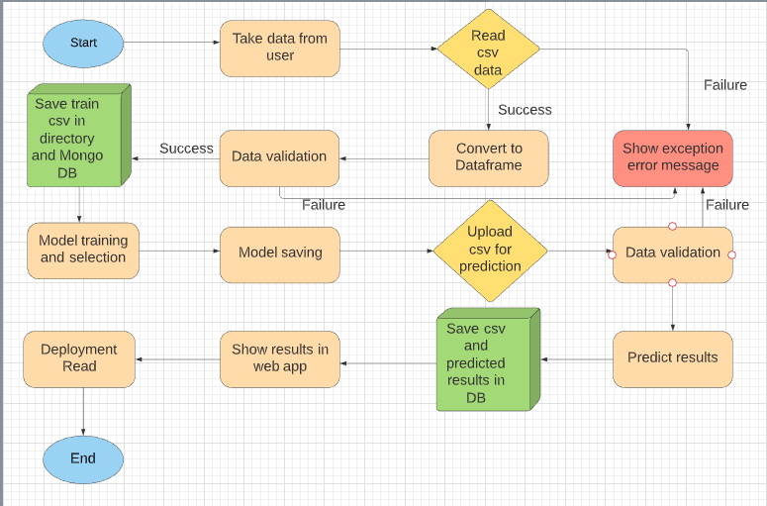
Flow Chart
Hemant & Jane
9

Slide 10
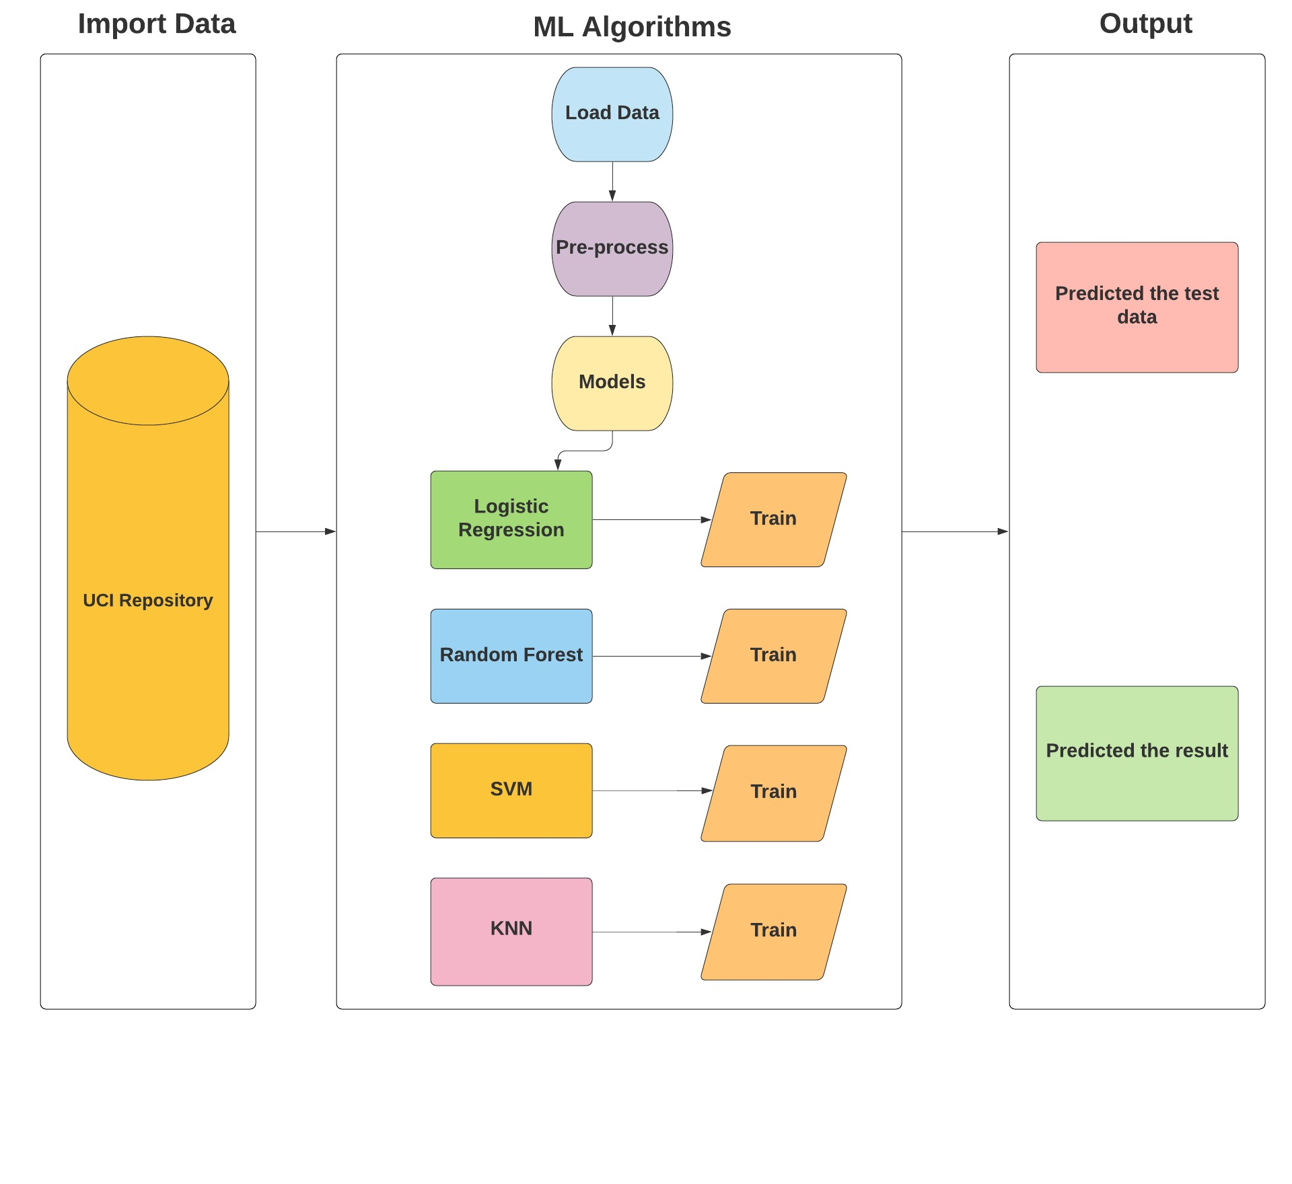
Classification Algorithms used for this problem

Slide 11
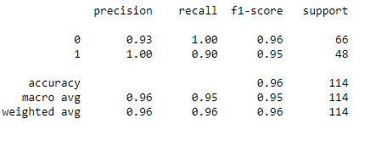
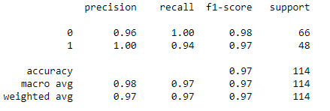
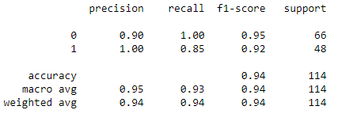
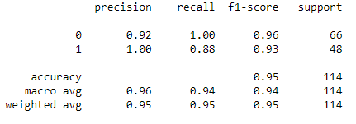
Classification Report
Logistic Regression
Random Forest
SVM
KNN

Slide 12

Best Model Accuracy
Algorithm
Random Forest
97 %

Slide 13
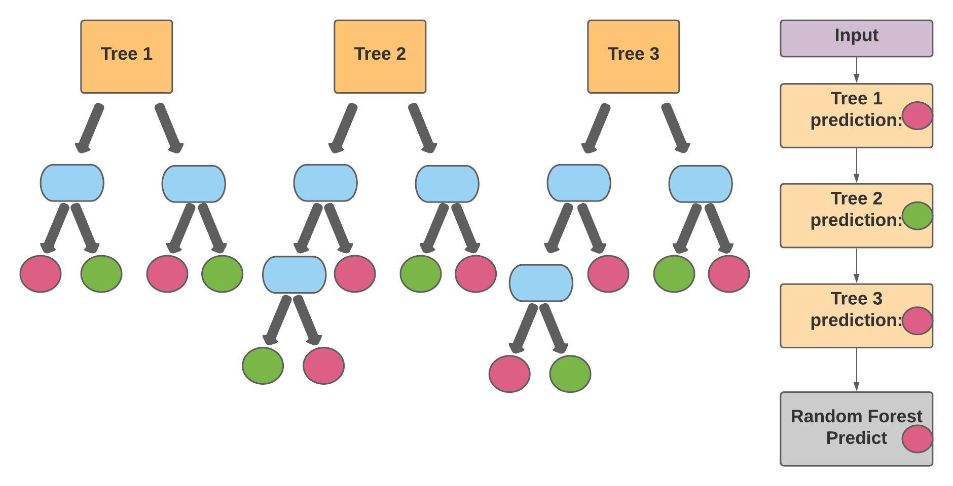
Explanation of Random Forest Algorithm
Hemant & Jane

Slide 14
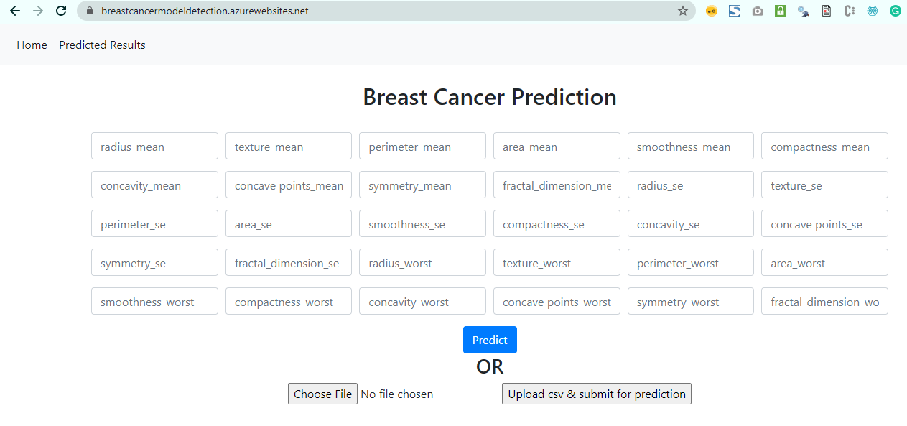
Web App
Hemant & Jane

Slide 15
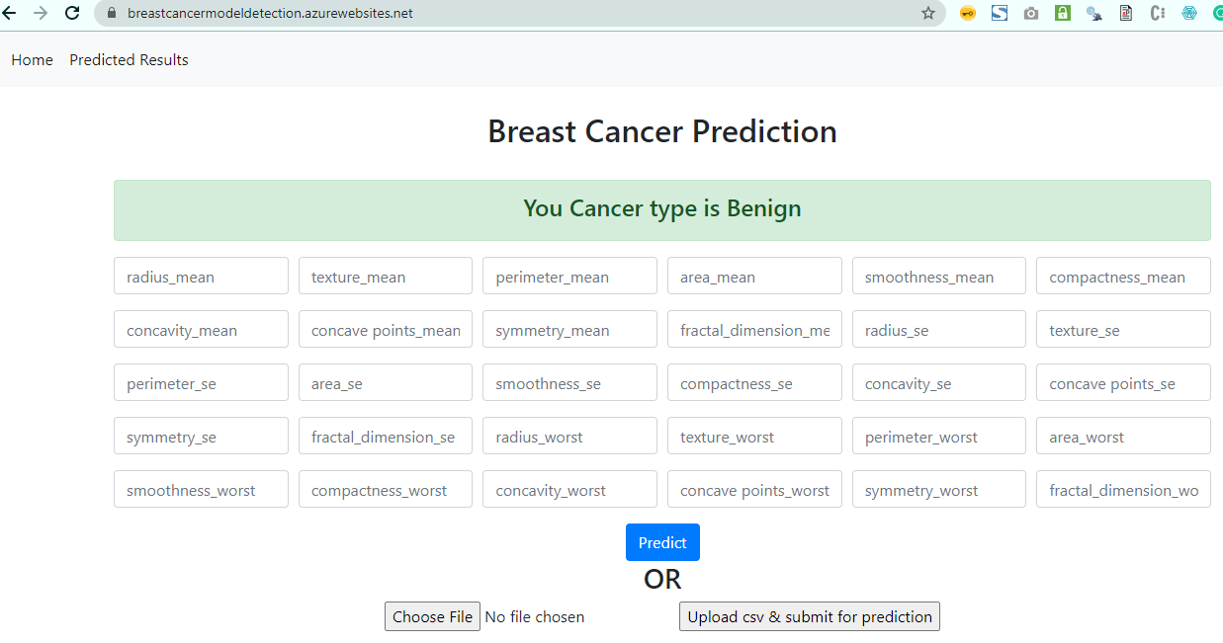
Single Prediction
Hemant & Jane

Slide 16
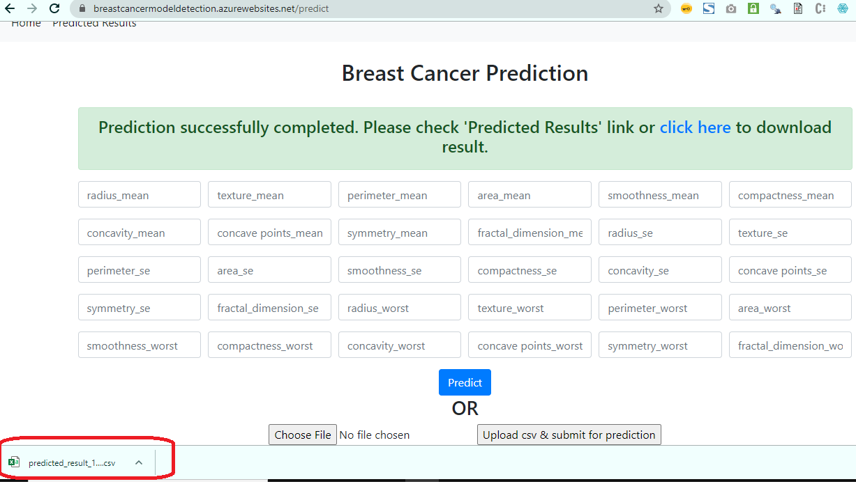
Bulk Prediction
Hemant & Jane

Slide 17
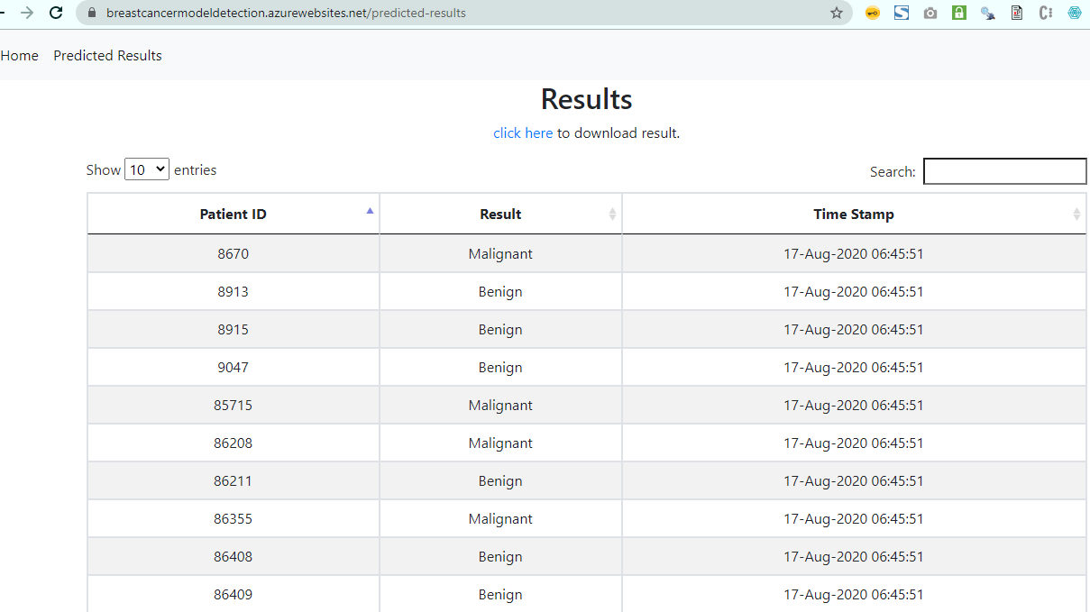
Predicted Result
Hemant & Jane

Slide 18



Challenges
Deployment in AWS/GCP
Dockerization in Kubernetes Engine
Hemant & Jane
18

Slide 19





Learning Outcomes
Hemant & Jane
19

Slide 20


Project information
GitHub: https://github.com/hemantgautam/breast_cancer_detection_main
Azure Link: https://breastcancermodeldetection.azurewebsites.net/
LLD document link: https://github.com/hemantgautam/breast_cancer_detection_main/blob/master/documents/Breast_Cancer_Detection_LLD.docx
Hemant & Jane

Slide 21
Conclusions
Breast cancer if found at an early stage will help save lives of thousands of women
This project helps the patients and doctors to gather as much information as they can.
UCI repository helped us to get the data for this project done by us. By using machine learning algorithms we will be able to classify and predict the cancer into Benign or Malignant.
In this project, four classification algorithms are used to find the best results and Random forest has given the best accuracy of 97%
Hemant & Jane

Slide 22
Acknowledgment
We would like to thank our Project Lead Mr. Mohit Kashyap & Mr. Virat Sagar for their continuous support and valuable suggestions throughout this work carried out by us.
We would also like to thank Mr. Sudhanshu Kumar, CEO & Chief AI Engineer, iNeuron Bangalore for giving us an opportunity to do an internship.
Hemant & Jane

Slide 23
References
Ultrasound characterisation of breast masses, The Indian journal of radiology imaging by S. Gokhale., Vol. 19, pp. 242-249, 2009.
K. Elissa, Title of paper if known, unpublished.
Breast Cancer Prediction Using Genetic Algorithm Based Ensemble Approach by Pragya Chauhan and Amit Swami, 18 October 2018
On Breast Cancer Detection: An Application of Machine Learning Algorithms on the Wisconsin Diagnostic Dataset by Abien Fred M.Agarap, 7 February 2019
Analysis of Machine Learning Techniques for Breast Cancer Prediction by the Priyanka Gupta and Prof. Shalini L of VIT university, Vellore, 5 May 2018.
Hemant & Jane

